Slide 1

Final Software Project Week 5 Assignment Steven Warnock The University of Arizona Global Campus CST 499 Capstone for Computer Software Technology Charmelia Butler 11/2/2024

Slide 2
Agenda
SRS Document
UML Design Model
Landing, Login, and Enrollment Pages
MySQL Database and Class Registration
PHP Code

Slide 3

SRS Document

Slide 4
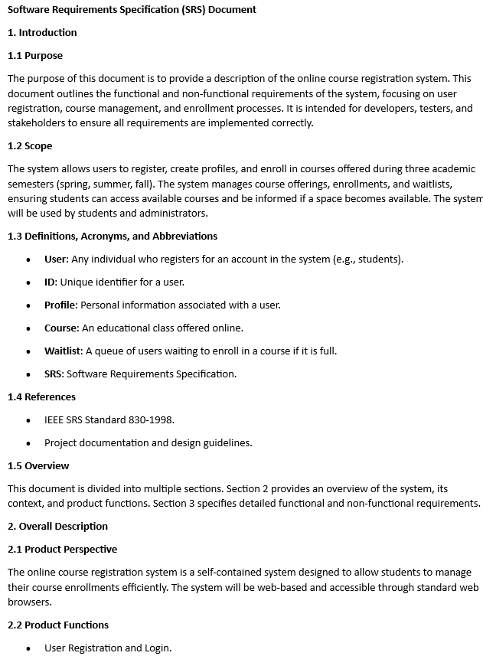
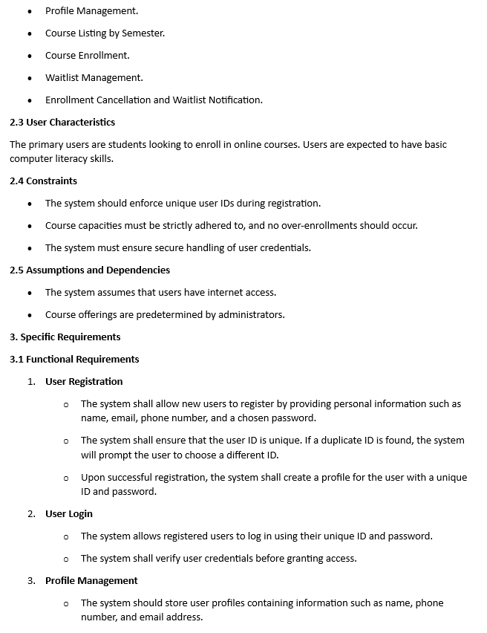

Slide 5
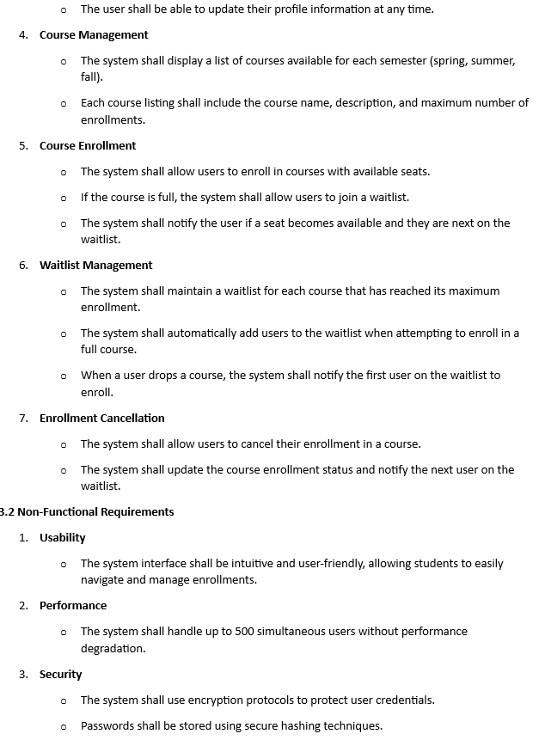
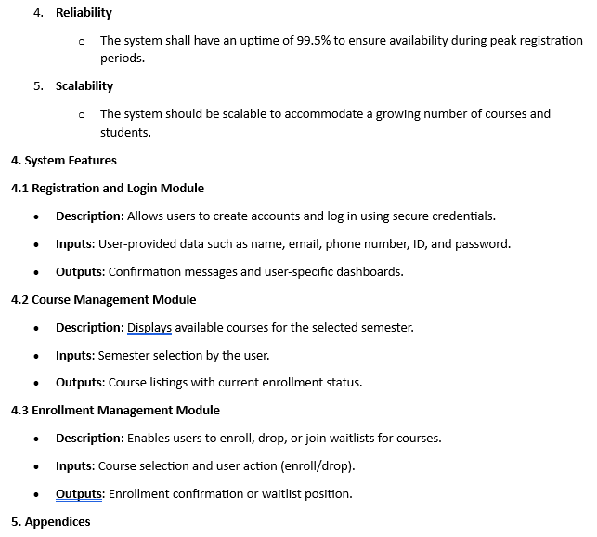

Slide 6

UML Design Model

Slide 7
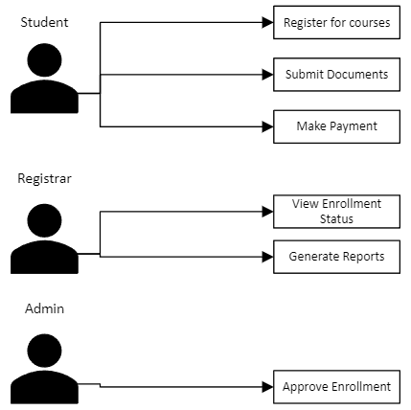
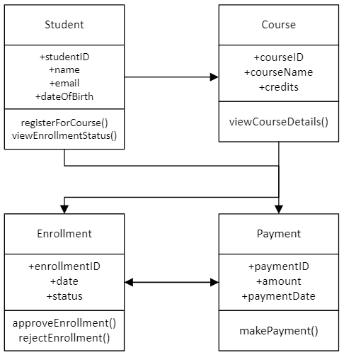
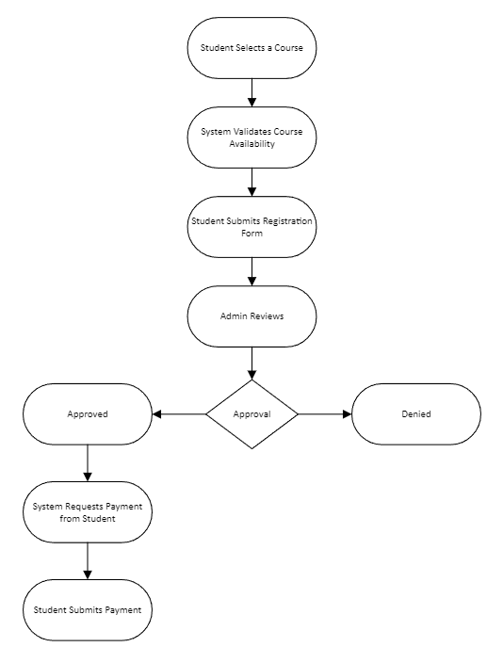
UML Design
UML Class Diagram
Activity Diagram

Slide 8

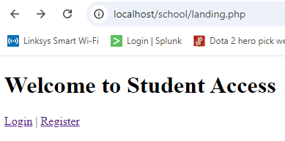
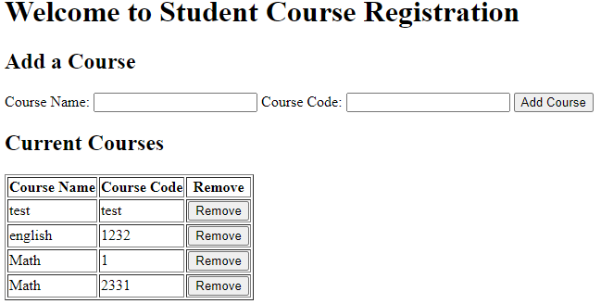
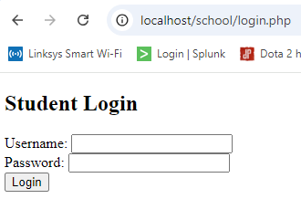
Landing, Login, and Enrollment Pages
Landing Page
Registration Page
Login Page

Slide 9

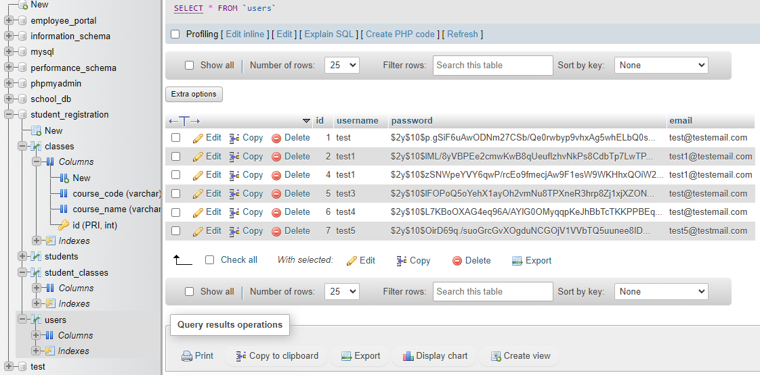
MySQL Database

Slide 10
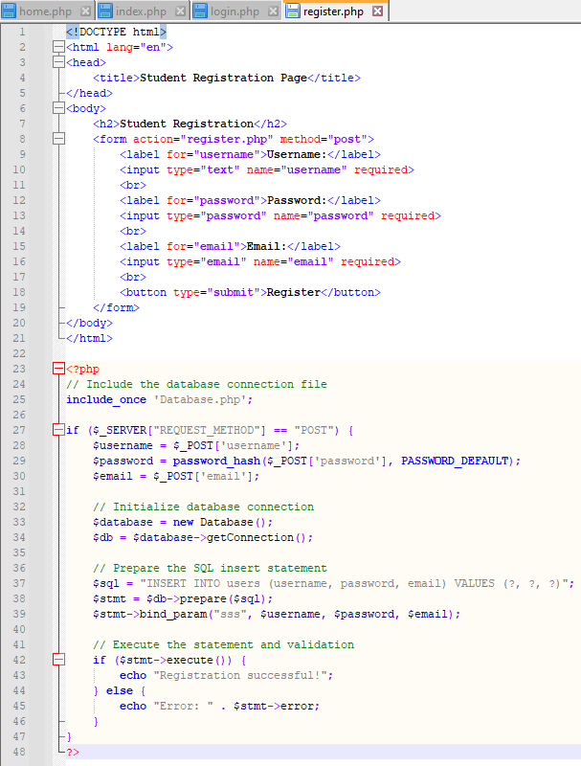
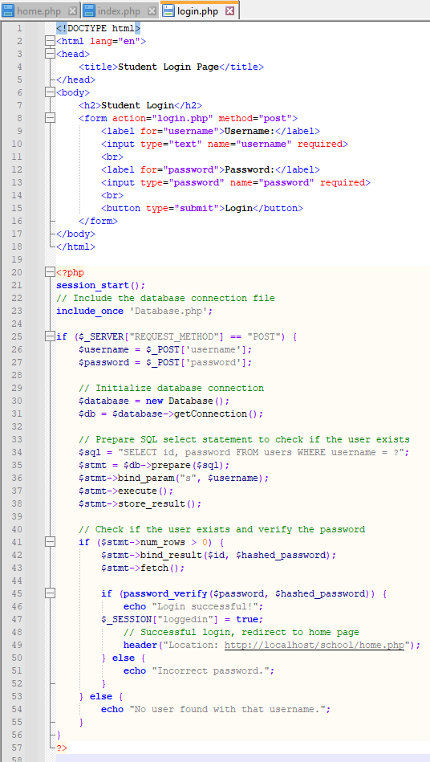
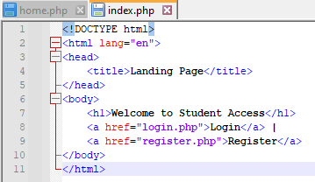
PHP Code
Access Registration
Login
Index

Slide 11
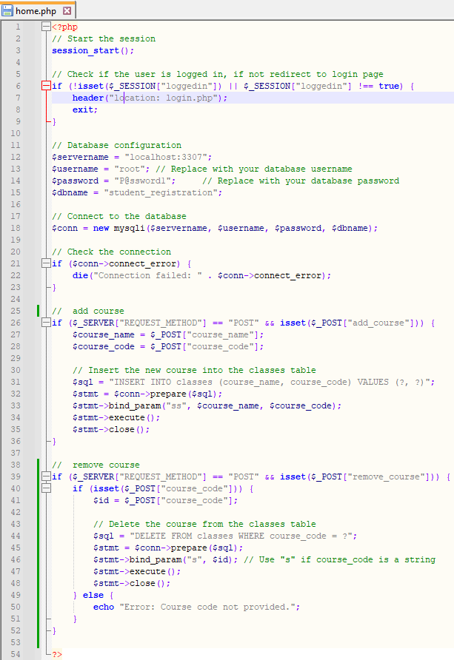
PHP Code (Cont.)
Class Registration

Slide 12
References
(2024) Classification of Software Requirements – Software Engineering. GeeksforGeeks. https://www.geeksforgeeks.org/software-engineering-classification-of-software-requirements/
(2024) SDLC V-Model – Software Engineering. Geeks for Geeks. https://www.geeksforgeeks.org/software-engineering-sdlc-v-model/
Bolloju, N., Alter, S. (2016) Better Use Case Diagrams by Using Work System Snapshots. The University of San Francisco. https://repository.usfca.edu/cgi/viewcontent.cgi?article=1088&context=at
Connolly, R., & Hoar, R. (2022). Fundamentals of web development (3rd ed.). Pearson.
Firesmith, D. (2013) Using V Models for Testing. Software Engineering Institute of Carnegie Mellon University. https://insights.sei.cmu.edu/blog/using-v-models-for-testing/
IEEE Recommended Practice for Software Requirements Specifications. IEEE Std 830-1998 , vol., no., pp.1-40, 20 Oct. 1998, doi: 10.1109/IEEESTD.1998.88286. https://ieeexplore.ieee.org/stamp/stamp.jsp?tp=&arnumber=720574
Krishna, M., Gaur, B., Verma, A., & Jalote, P. (2024) Using LLMs in Software Requirements Specifications: An Empirical Evaluation. 2024 IEEE 32nd International Requirements Engineering Conference (RE). https://ieeexplore.ieee.org/stamp/stamp.jsp?tp=&arnumber=10628461
Mancordis, S. (1999, September 27). Topics in object-oriented design patternsLinks to an external site. [Presentation slides]. Retrieved from http://research.cs.queensu.ca/home/ahmed/home/teaching/CISC322/F08/files/Slides_Spiros_Patterns.pdf
Mathur, S., Malik, S. (2010) Advancements in the V-Model. International Journal of Computer Applications. https://citeseerx.ist.psu.edu/document?repid=rep1&type=pdf&doi=04aca97824d178d7ca3688bbed2118d0115dfaba
Nasir, O. (2023) 7 Tips to identify Software Requirements for a Successful Development Cycle. Tkxel. https://tkxel.com/blog/7-tips-to-identify-software-requirements-for-a-successful-development-cycle/
Psinas, M. (2012, March 12). Role based access control in PHPLinks to an external site.. Retrieved from https://www.sitepoint.com/role-based-access-control-in-php/
Tsui, F., Karam, O., & Bernal, B. (2018). Essentials of software engineering (4th ed.). Jones & Bartlett Learning.

Slide 13

Thank you!

